Slide 1
VM Simulator Design

Slide 2
Content
VM architecture
TLB design
Huge page support
Evaluation
Test input format
Metrics

Slide 3
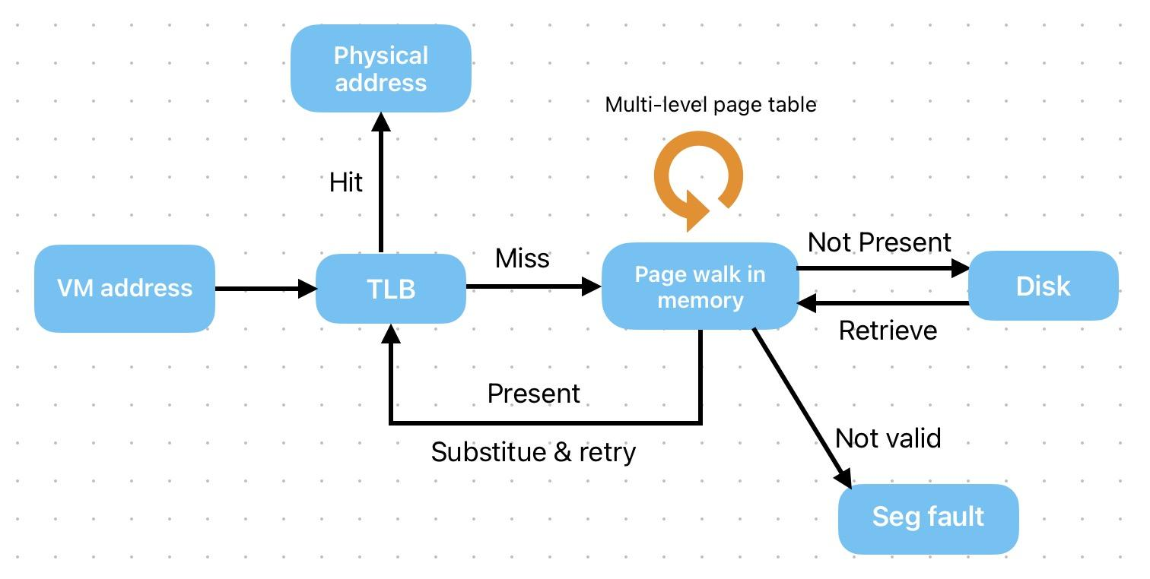
Flow Chart

Slide 4
TLB Design
2 level TLB, L1 and L2
L1 TLB:
64 entries
Fully associative
Flush when switching process
L2 TLB:
1024 entries
Set associative
Shared by multiple processes
Query both TLBs in parallel (theoretically, at the simulator level we have to do that sequentially)

Slide 5
Huge page support
Modern commercial CPUs, such as Intel and AMD ones, only support a few page sizes, typically 4KB, 2MB and 1GB.
We have nothing to worry about, so why not make it more interesting?
Our design: support all page sizes from 4KB to 1GB (by a factor of 2)

Slide 6
Support in TLB
X bits virtual page number
Y bits offset
Virtual address example
To support all page sizes from 4KB to 1GB, X could be any number between 2 to 20
We can compute the actual VPN from the longest VPN (20 bits) using a mask with length m.
Longest possible VPN (20 bits)
&
0xF0000
Problem: page table entry size!
Actual VPN
(4 bits)

Slide 7
Page table entry
A PTE entry must be exact 1 word wide, or we have to access the memory twice to read it into the TLB, that leaves only 12 bits to the flags and mask!
Recall: the mask could be 0 to 18 bits long. We don’t have enough space!
One possible solution: store the length of mask instead of the mask itself, 5 bits are enough.
However, this will slow down the translation because we have to compute the mask every time when we query the TLB. It’s even more unacceptable!
20 bits physical frame number
12 bits offset

Slide 8
Moderate solution
In systems, we do space-time tradeoffs all the time.
Compute the mask when fetching the PTE into TLB and only store it in the TLB.
20 bits VPN
20 bits mask
4 bits flags
20 bits PFN
Some issues to address:
Allocation algorithm when no consecutive memory frames can satisfy the huge page allocation request.
Huge pages can only start at the “naturally aligned” addresses.
Physical memory gets more and more fragmented.

Slide 9
Content
VM architecture
TLB design
Huge page support
Evaluation
Test input format
Metrics

Slide 10
Test input format
To measure the performance of different parameters and algorithms, we have to perform extensive experiments - can’t just use some command line arguments!
Basic format:
Process id action size/position
1 access 0x0050
1 allocate 100
2 switch null
2 access 0x0050
2 free 0x0050
Then, we can write a generator to generate massive tests!

Slide 11
Metrics
To evaluate the performance, we decided to measure the following metrics:
L1 TLB hits
L2 TLB hits
Memory accesses
Disk accesses
Mode switches (user & kernel mode)

Slide 12
Performance
After having collected the aforementioned statistics, we can quantify the performance of our simulator. E.g.:
Total CPU cycles
L1/L2 TLB hit rate
Average memory access time
Etc…

